Slide 1
SRS Ecommerce Website for Imamima Online Shop
Prepared by : Md Yasin Arif
Supervised by : Rajaul Islam
Technology : Jsf, Primeface, Hibernate & MySql

Slide 2
Requirements
Imamima Shop wants to develop there product selling system using a Online Ecommerce Website they want to record there all product and product information (purchase & sales) and get payment though online payment gateway.

Slide 3
Requirements analysis
Add Product Category
Add Product Sub-Category
Add Product & Product Details
Purchase Product
Summary of the Select Products list.
Make Online Payment

Slide 4
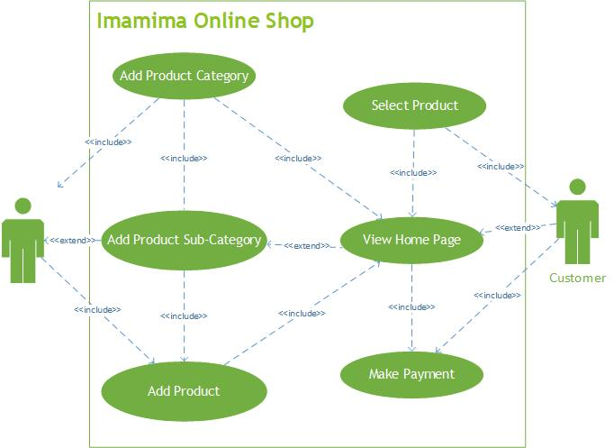
Use Case

Slide 5
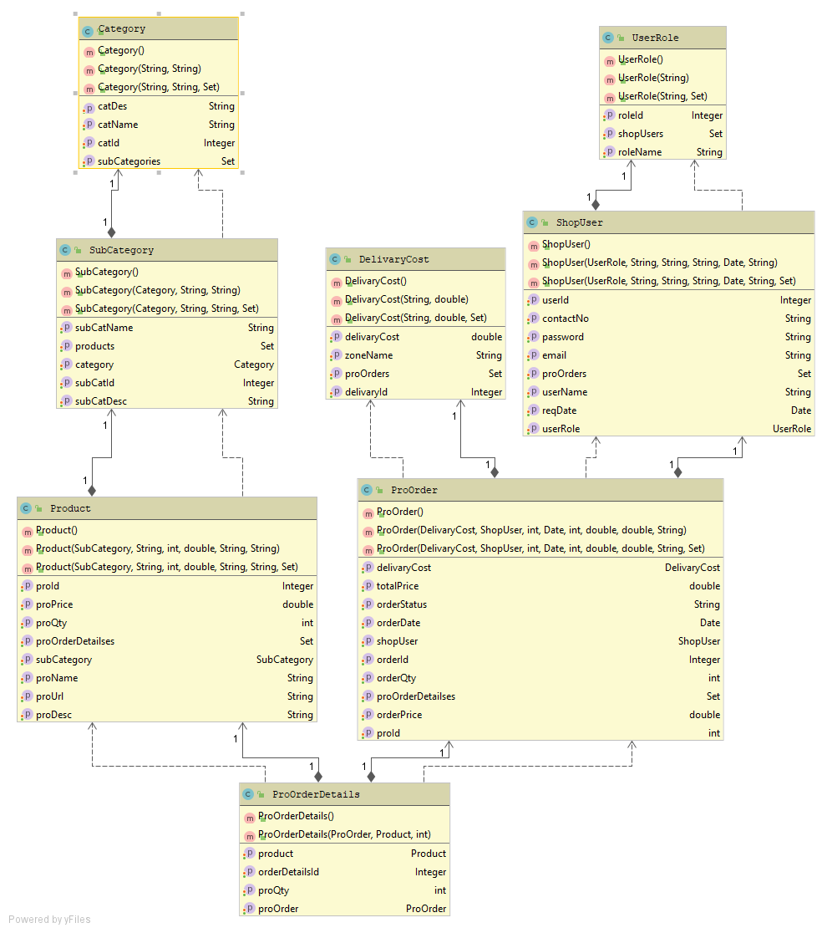
Class Diagram

Slide 6
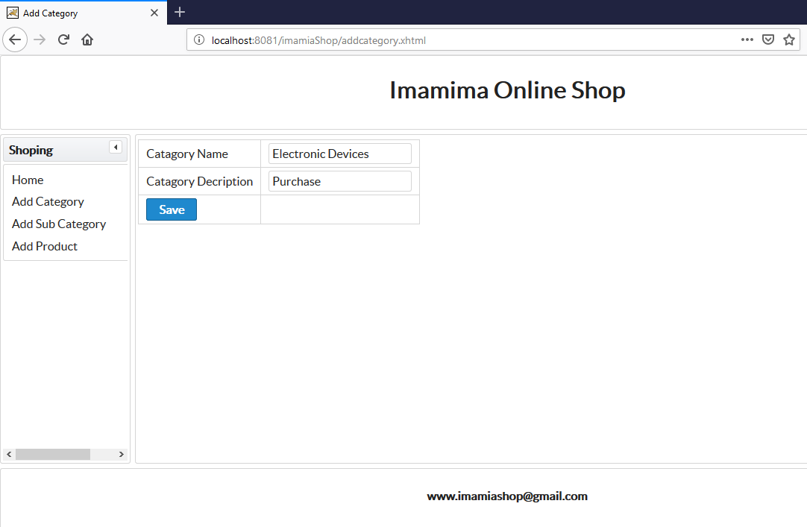
Add Product Category

Slide 7
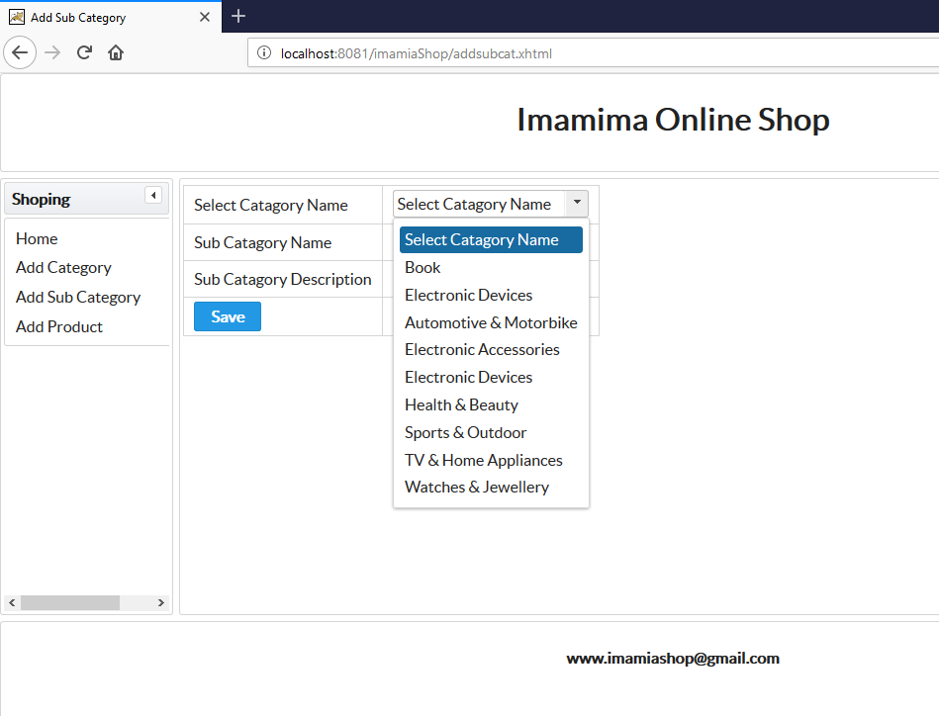
Show Category List into sub-Category Page

Slide 8
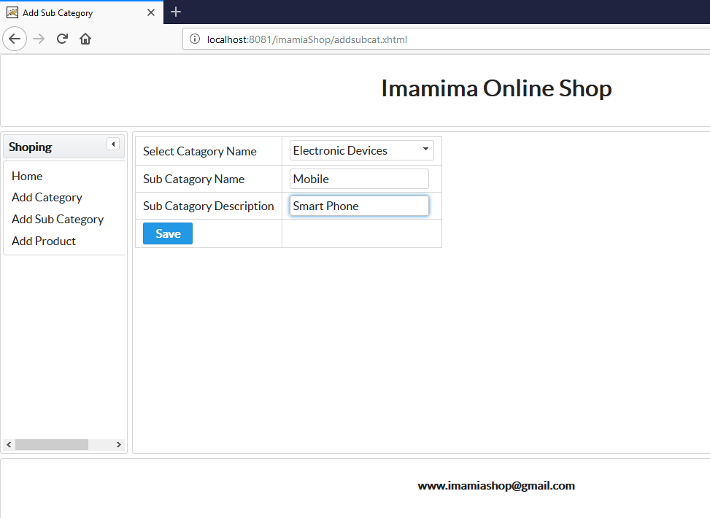
Add Product Sub-Category

Slide 9
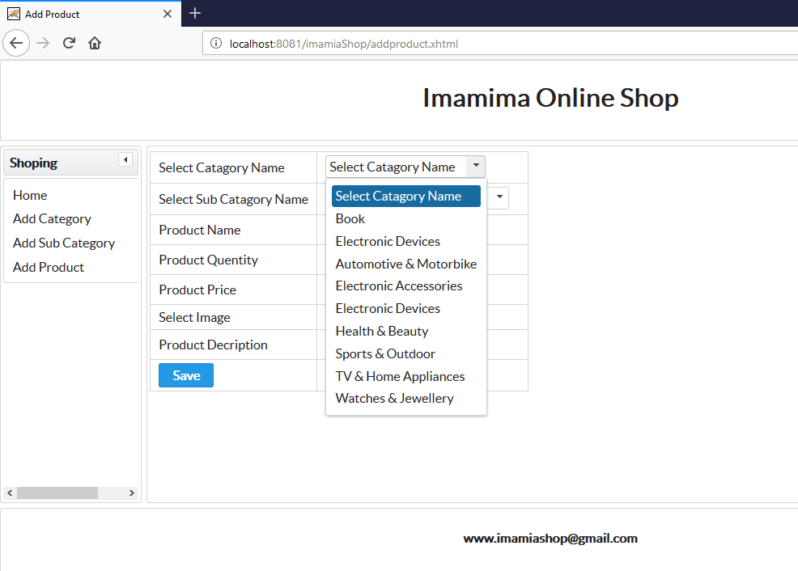
Show sub-Category List into product page

Slide 10
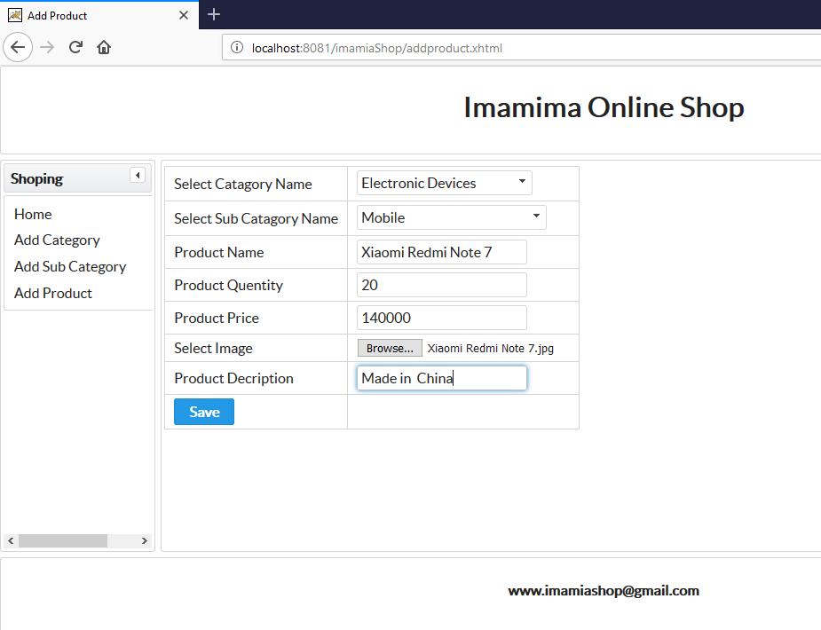
Add Product & Product Details

Slide 11
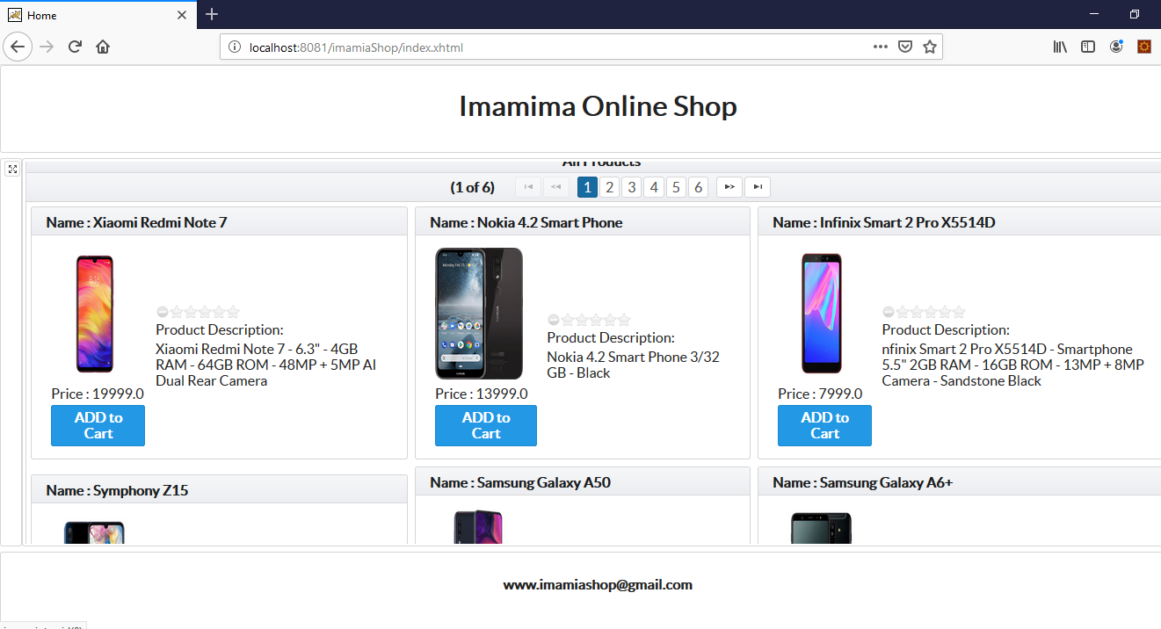
Home

Slide 12
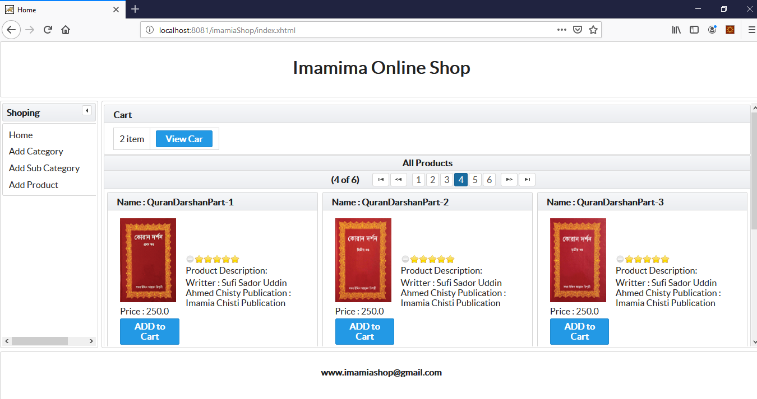
Add to Cart

Slide 13
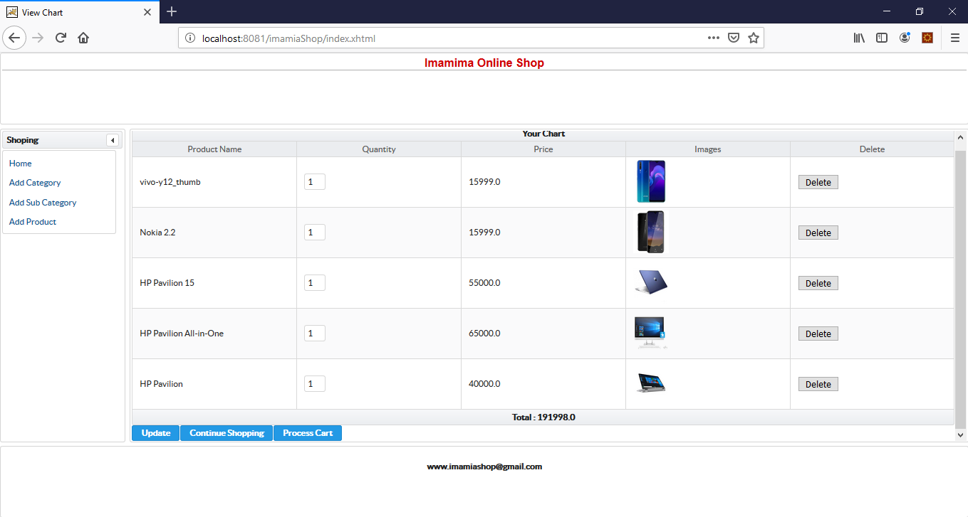
View Cart

Slide 14
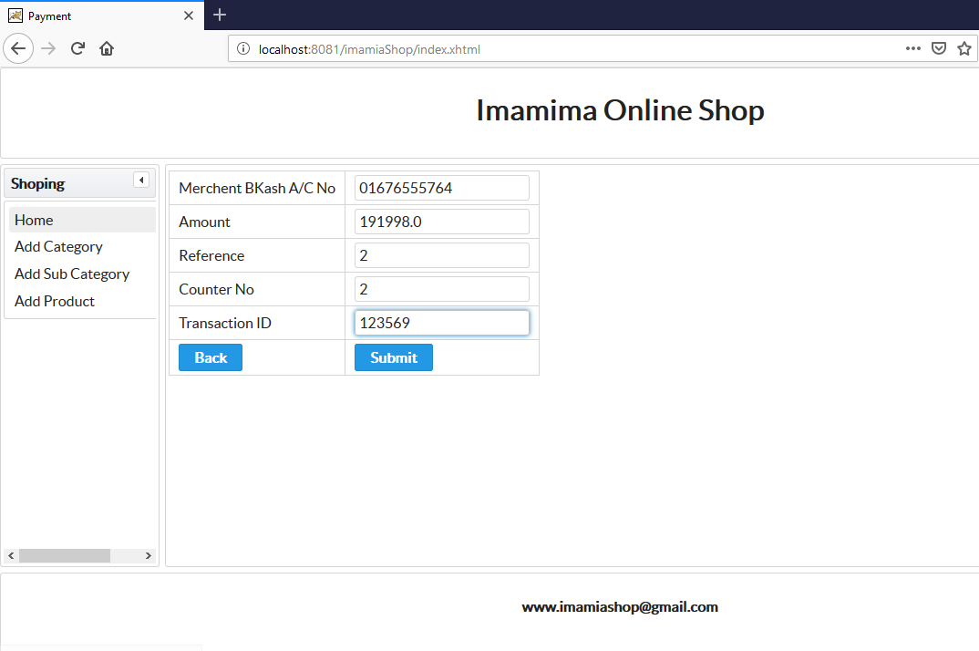
Make Payment

